Slide 1
The Nature of Software and Software Engineering
COMP6100001 - Software engineering
Session 01
Kenny Jingga, S.Kom., M.T.

Slide 2
Session 01 – The Nature of Software and Software Engineering
Learning objectives
At the end of this session, students will be expected to be able to:
Understand the Definition and Importance of Software Engineering
Explain Key Characteristics of Software and the Challenges They Present
Identify Core Trade-offs and Costs in Software Development
Explore the Role of Software Engineers in Industry

Slide 3
Session 01 – The Nature of Software and Software Engineering
Content outline
Definition of Software and Software Engineering
Importance of Software in Modern Society
Trade-offs and Costs
Time and Change
Characteristics of Software Systems
Scale and Efficiency
The Software Engineering Profession

Slide 4
Software is everywhere
When software fails, consequences are real.

Slide 5

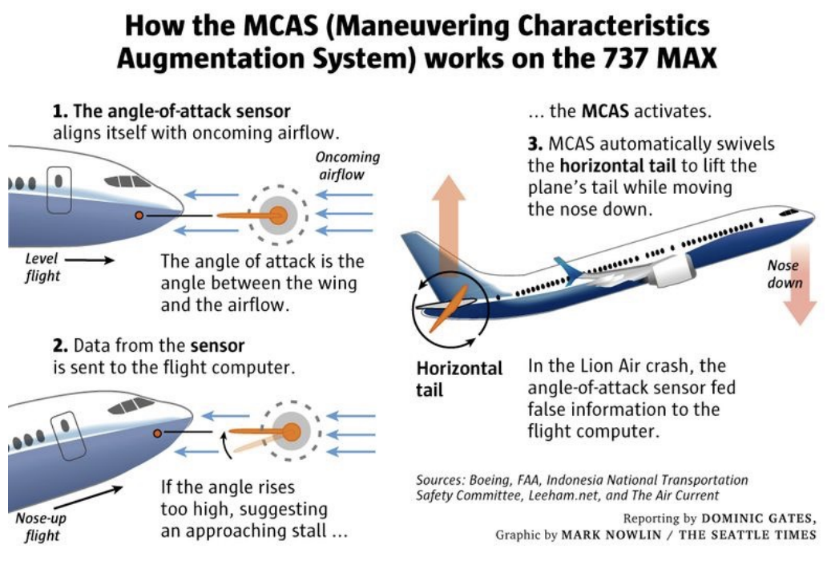
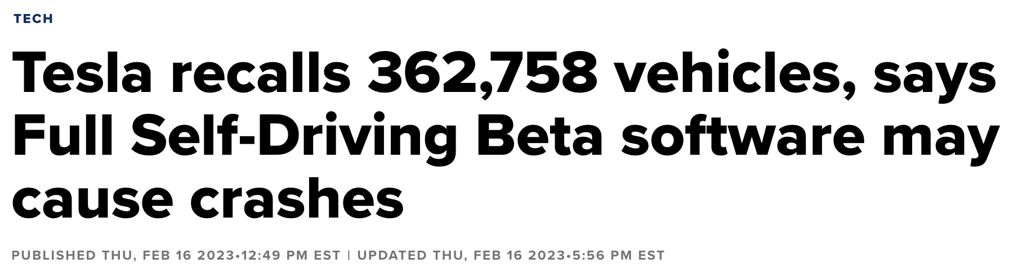
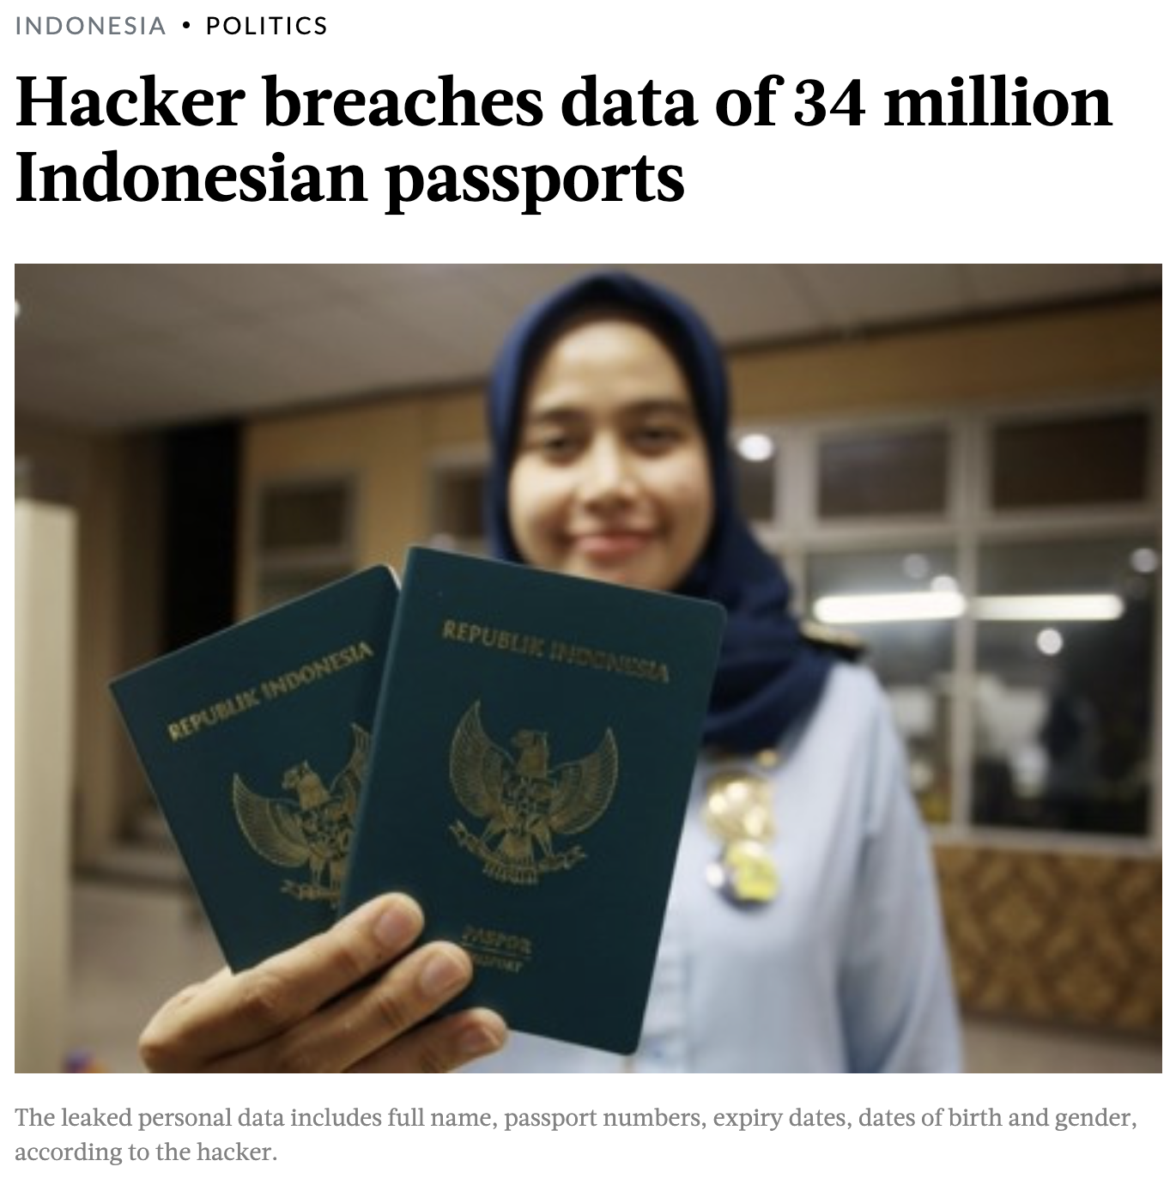
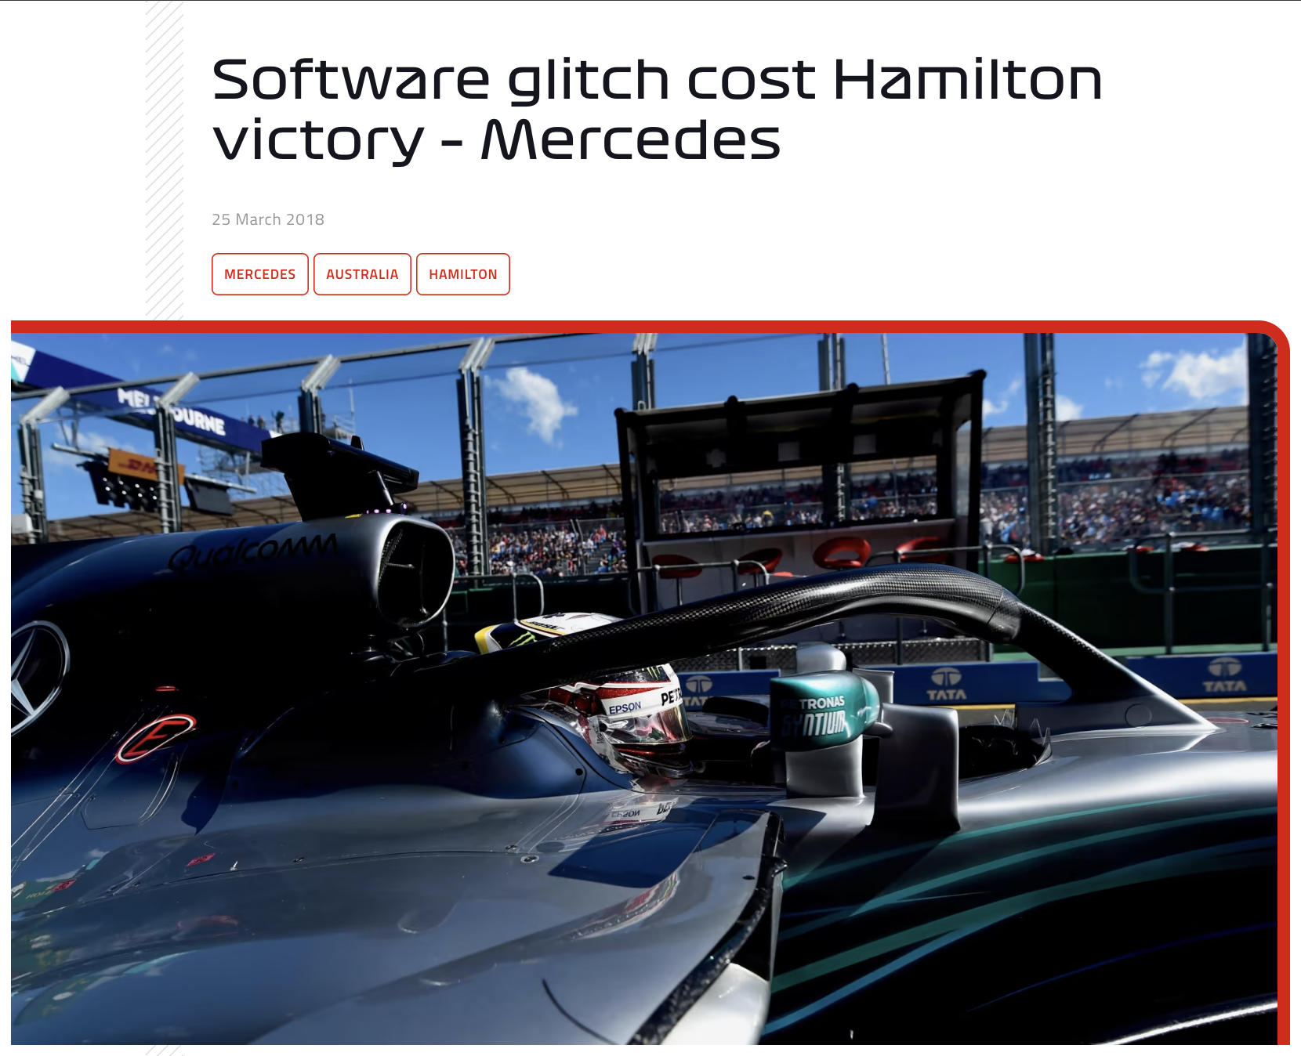
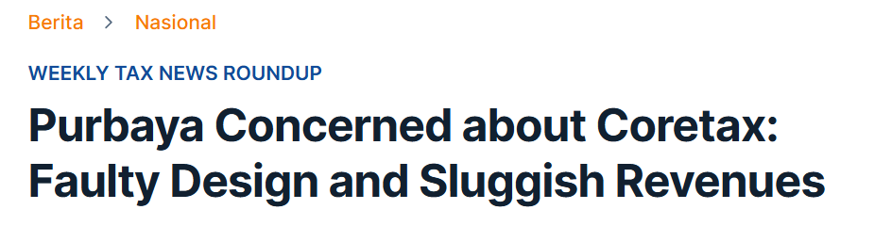
Software is Everywhere
Issues in Software or system
https://www.cnbc.com/2023/02/16/tesla-recalls-362758-vehicles-says-full-self-driving-beta-software-may-cause-crashes.html
https://www.seattletimes.com/business/boeing-aerospace/failed-certification-faa-missed-safety-issues-in-the-737-max-system-implicated-in-the-lion-air-crash/
https://www.theverge.com/2019/5/2/18518176/boeing-737-max-crash-problems-human-error-mcas-faa
https://www.thejakartapost.com/indonesia/2023/07/06/hacker-breaches-data-of-34-million-indonesian-passports.html
https://www.formula1.com/en/latest/article.software-glitch-cost-hamilton-victory-mercedes.6VzyCYpEpauaIYsOWYCqYS.html
https://news.ddtc.co.id/berita/nasional/1814552/purbaya-concerned-about-coretax-faulty-design-and-sluggish-revenues

Slide 6
What is Software Engineering?
What is Software?
Software is:
Instructions (computer programs) that when executed provide desired features, function, and performance;
Data structures that enable the programs to adequately manipulate information; and
Descriptive information in both hard copy and virtual forms that describes the operation and use of the programs.
The IEEE definition: The application of a systematic, disciplined, quantifiable approach to the development, operation, and maintenance of software; that is, the application of engineering to software.

Slide 7









What is Software Engineering?
Software Application Domains (1/3)
System software. A collection of programs written to service other programs.
Application software. Stand-alone programs that solve a specific business need.
Engineering/scientific software. A broad array of “number-crunching” or data science programs that range from astronomy to volcanology, from automotive stress analysis to orbital dynamics, from computer-aided design to consumer spending habits, and from genetic analysis to meteorology.
Notes:
System Software
Microsoft Windows — Used to manage computer hardware and run applications on PCs.
Linux — Used to operate servers, embedded systems, and open-source platforms.
macOS — Used to run Apple desktop and laptop computers.
Application Software
Microsoft Word — Used to create and edit text documents.
Adobe Photoshop — Used to edit and manipulate images and graphics.
SAP ERP — Used to manage business processes such as finance and operations.
Engineering / Scientific Software
MATLAB — Used for numerical computation, data analysis, and simulation.
ANSYS — Used to simulate physical and engineering systems.
NASA — Used to support space missions, navigation, and scientific research.

Slide 8




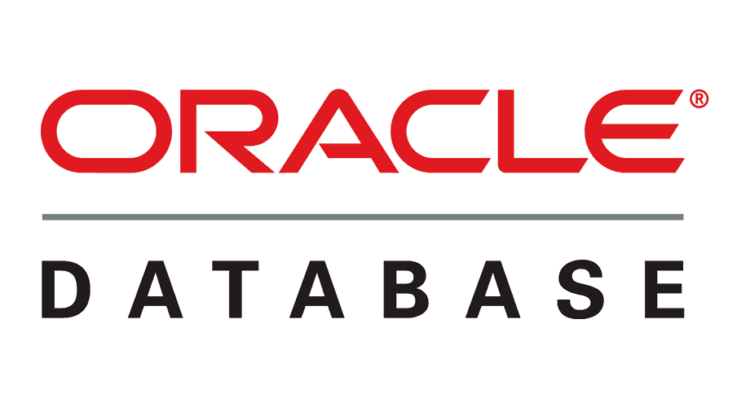

What is Software Engineering?
Software Application Domains (2/3)
Product-line software. Composed of reusable components and designed to provide specific capabilities for use by many different customers.
Embedded software. Resides within a product or system and is used to implement and control features and functions for the end user and for the system itself.
Notes:
Embedded Software
Tesla Autopilot — Used to assist and automate vehicle driving functions.
Bosch — Used to control automotive and industrial hardware systems.
Samsung — Used to control and operate smart home devices.
Product-Line Software
Microsoft Office — Used for office productivity tasks such as documents and spreadsheets.
Autodesk AutoCAD — Used for computer-aided design and drafting.
Oracle Database — Used to store, manage, and query structured data.

Slide 9







What is Software Engineering?
Software Application Domains (3/3)
Web/mobile applications. This network-centric software category spans a wide array of applications and encompasses browser-based apps, cloud computing, service-based computing, and software that resides on mobile devices.
Artificial intelligence software. Applications within this area include robotics, decision-making systems, pattern recognition (image and voice), machine learning, theorem proving, and game playing.
Notes:
Web / Mobile Applications
Google Search — Used to search information on the internet.
Tokopedia — Used to buy and sell products online.
Instagram — Used to share photos, videos, and social content.
Artificial Intelligence Software
ChatGPT — Used to generate and understand natural language.
Google Translate — Used to translate text between languages.
Gemini — Used to generate and understand natural language.

Slide 10
What is Software Engineering?
Software Engineering vs Programming
“Software engineering is programming integrated over time”
 | Programming | Software Engineering
Core idea | Immediate act of producing code | “Programming integrated over time” (building + sustaining software)
Primary focus | Development (write code to make it work) | Development plus modification, maintenance, evolution
Typical activities | Coding, debugging, small refactors | Requirements, architecture/design, coding, testing, CI/CD, documentation, reviews, monitoring, maintenance
Team collaboration | Can be solo or small team | Designed for teamwork: standards, processes, shared tooling
Quality attributes emphasized | Functionality, basic correctness | Maintainability, reliability, scalability, security, usability, performance
Deliverable | Working code / feature | Working product/service + lifecycle support (updates, fixes, operations)
Success metric | Feature works / passes tests | Software stays valuable: fewer regressions, easier change, stable delivery, manageable cost
Notes:
Programming tasks focus only on development
Software engineering tasks focus on development, modification, maintenance
The difference stems from the management of code over time, the impact of time on scale, and decision making in the face of those ideas
Programming is the immediate act of producing code
Software engineering is the set of policies, practices, and tools that are necessary to make that code useful for as long as it needs to be used and allowing collaboration across a team

Slide 11

What is Software Engineering?
Software Engineering Layers
Layer | What it is | What it does
Process (foundation) | The framework for doing and managing the work | Defines activities, milestones, roles, and change control to deliver software effectively
Methods | Technical “how-to” for building software | Guides communication, requirements, design, coding, testing, and support
Tools | Automated/semi-automated support | Helps execute the process & methods efficiently; integrates workflows (CASE)
Process holds everything together → Methods tell how to build → Tools help you do it faster & consistently — all under a Quality Focus.
Notes:
The foundation for software engineering is the process layer. The software engineering process is the glue that holds the technology layers together and enables rational and timely development of computer software. Process defines a framework that must be established for effective delivery of software engineering technology. The software process forms the basis for management control of software projects and establishes the context in which technical methods are applied, work products (models, documents, data, reports, forms, etc.) are produced, milestones are established, quality is ensured, and change is properly managed. Software engineering methods provide the technical how-to’s for building software. Methods encompass a broad array of tasks that include communication, requirements analysis, design modeling, program construction, testing, and support. Software engineering methods rely on a set of basic principles that govern each area of the technology and include modeling activities and other descriptive techniques. Software engineering tools provide automated or semi-automated support for the process and the methods. When tools are integrated so that information created by one tool can be used by another, a system for the support of software development, called computer-aided software engineering, is established.

Slide 12
We’ve Seen The Layers. Now Here’s What Happens When Process/Requirements/Change Control Are Weak
- Vasa Syndrome -

Slide 13
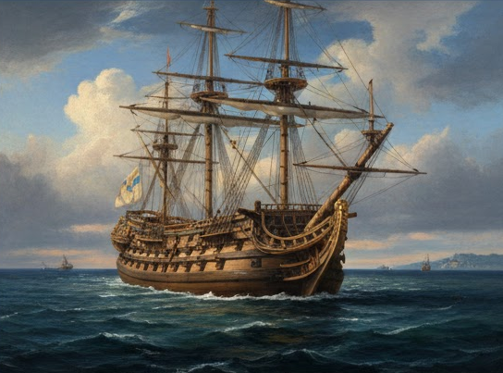
Vasa Syndrome
Story of Vasa
Vasa, 17th-century vessel, the mightiest warship of its day, that sank on its maiden voyage, on 10th August 1628 in Baltic Sea
Vasa (1628): Sweden’s flagship warship, sank on its maiden voyage in the Baltic Sea.
Built during wartime pressure: the King wanted a stronger naval presence fast.
Design kept changing: more weapons / bigger ship, while deadlines stayed tight.
Problems piled up: constant modifications, budget delays, and loss of key expert(s) → unstable final design.
On launch day, with gun ports open, a gust caused heavy heel (tilt) → water entered → the ship sank near shore.
Afterward, blame was unclear: decisions were spread across many people, including leadership changes.
Notes:
While the Thirty Years’ War was raging in Europe, King Gustavus Adolphus of Sweden realized he needed a stronger naval presence if he were to retain his dominance in the Baltic.
He ordered five heavy-duty warships to be built. The Vasa, with two gun-decks, 64 bronze cannons, and a 450-man crew, was to be a mighty vessel; each broadside was capable of hurling some 250 kg (550 lb) of shot, which was twice as much as the most powerful European ships of her day.
But the project became fraught with problems: the King was pressing for quick delivery, yet he kept interfering with the plans, endlessly fiddling with measurements and demanding constant modifications; a shortage of money mid-project led to more delays; and to cap it all the head shipwright suddenly dropped dead.
At long last the Vasa was ready for her maiden voyage. It was a calm day with a light breeze—perfect sailing weather. The gun ports were opened ready to fire a salute.
After sailing only 1,130 m (3,700 ft) the sail suddenly billowed and the Vasa heeled violently to port. She immediately righted herself, but at the next gust she leant even further and disaster struck—water poured into the open gun ports.
The inrush made her heel so far that she collapsed on her side. The pride of the Swedish fleet met her ignominious end a mere 120 m (393 ft) from land in full view of a crowd of thousands.
Gustavus Adolphus was incandescent with rage. The ship’s captain was immediately arrested while the shipbuilders and the crew blamed each other. It soon became clear that it was the actual construction at fault. There was nobody to blame: the original contractor was dead, and the King himself had personally overseen every measurement. Everyone else had just obeyed orders.

Slide 14
Vasa Syndrome
What happened is now called “vasa Syndrome”
Changing shipbuilding orders
No specifications for modified keel
Shifting armaments requirements
Shipwright’s death
No way to calculate stability, stiffness, or sailing characteristics
Failed pre-launch stability tests

Slide 15
Vasa Syndrome
What happened is now called “vasa Syndrome”
Changing shipbuilding orders
No specifications for modified keel
Shifting armaments requirements
Shipwright’s death
No way to calculate stability, stiffness, or sailing characteristics
Failed pre-launch stability tests
Requirements
Teams
Metrics
QA

Slide 16
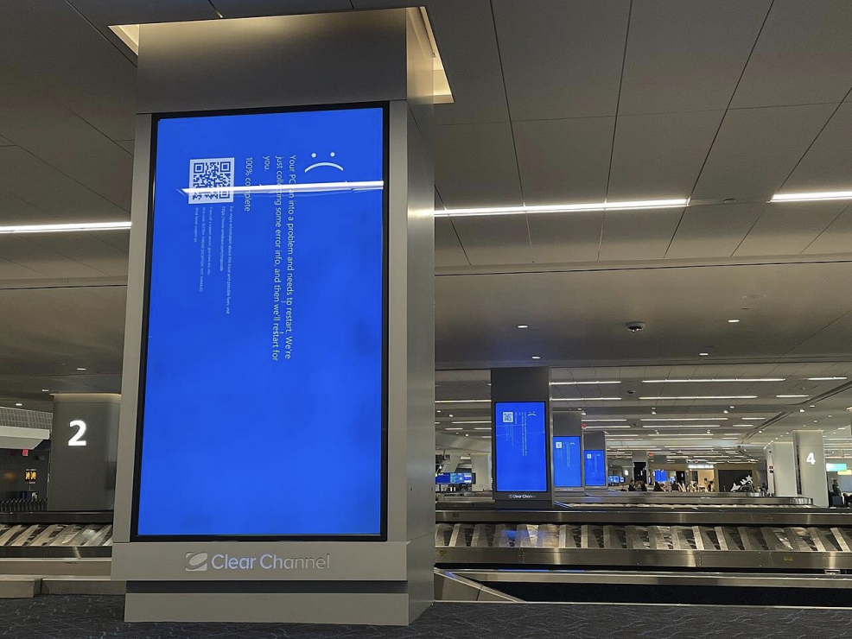
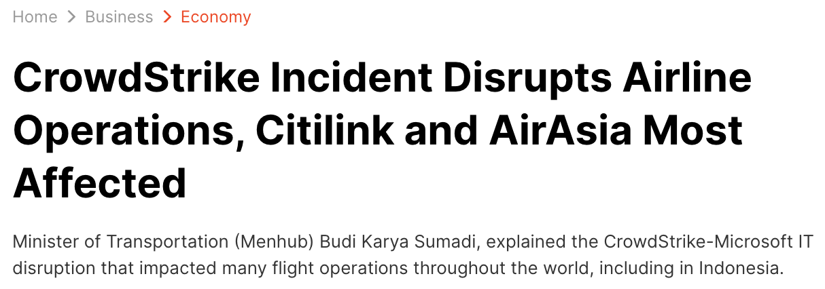
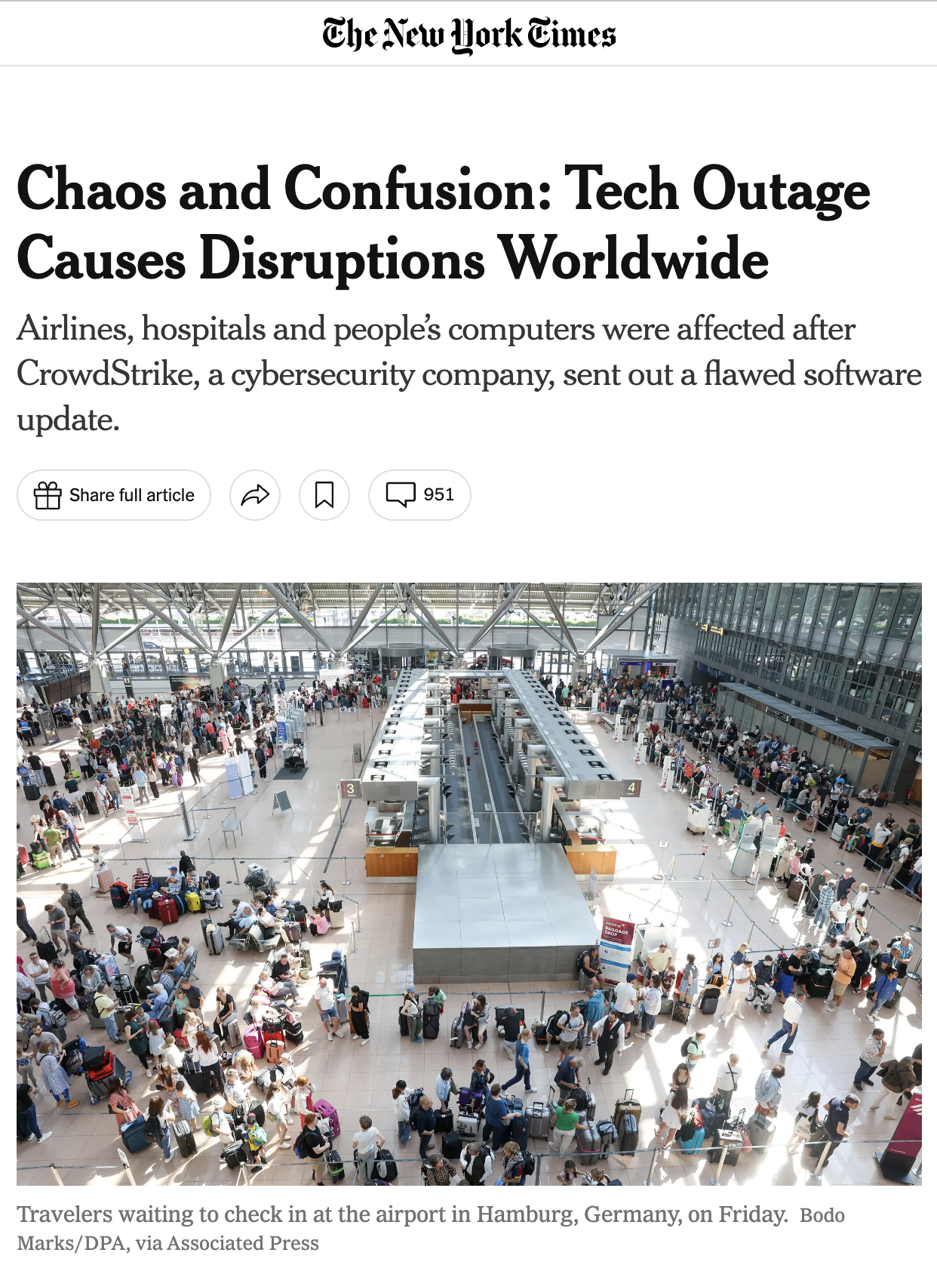
The Crowdstrike incident
Latest issue in software (2024)
https://www.liputan6.com/bisnis/read/5649816/insiden-crowdstrike-ganggu-operasional-maskapai-citilink-dan-airasia-paling-terdampak?page=2
LaGuardia Airport, New York City
Photo by Smishra1 - Own work, CC BY-SA 4.0, https://commons.wikimedia.org/w/index.php?curid=150535443
https://www.nytimes.com/2024/07/19/business/microsoft-outage-cause-azure-crowdstrike.html

Slide 17
The Crowdstrike incident
Complex Software Engineering issues involved
Software running with kernel-level privilege can crash the system (BSOD) and prevent booting
Content updates more continuous than software updates
Insufficient testing of content *and* parser
No staged roll-outs
No way to fix issue remotely after impact
Skewed incentives
Limited liability
Requirements
(Architecture & Design)
QA
DevOps
Metrics
Licenses

Slide 18
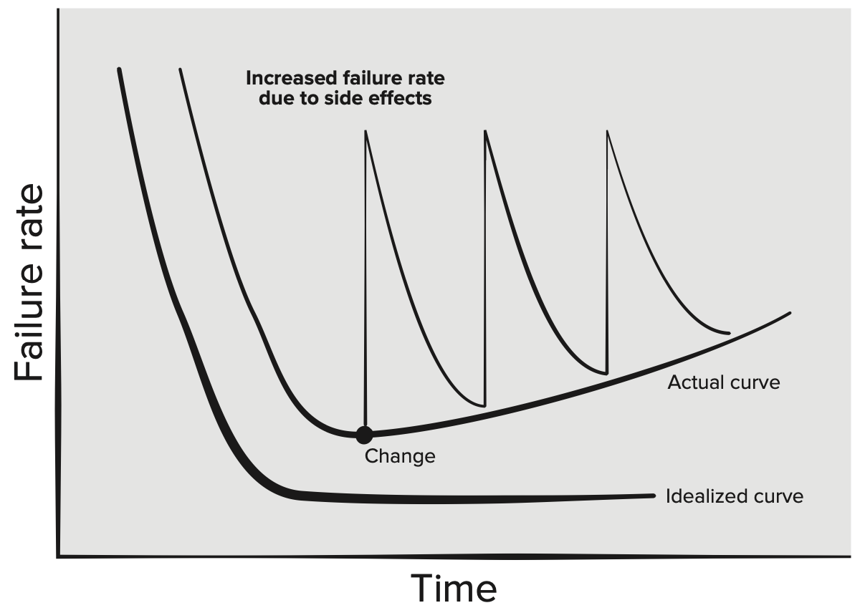
Time And Change
Unlike hardware, software doesn’t wear out. It deteriorates instead!
what “deteriorates” means:
Environment changes (OS, dependencies, APIs)
Evolving requirements
Eccumulated complexity/technical debt

Slide 19
Time And Change
Time
Successful projects have an effectively unbounded life span
Example: It is impossible to reasonably predict an endpoint for Google Search, the Linux kernel, or the Apache HTTP Server project
In developing projects → assume that projects will live indefinitely—we cannot predict when we won’t need to upgrade our dependencies, language versions, and so on
As their lifetimes grow, these long-lived projects eventually have a different feel to them than programming assignments or start-up development

Slide 20
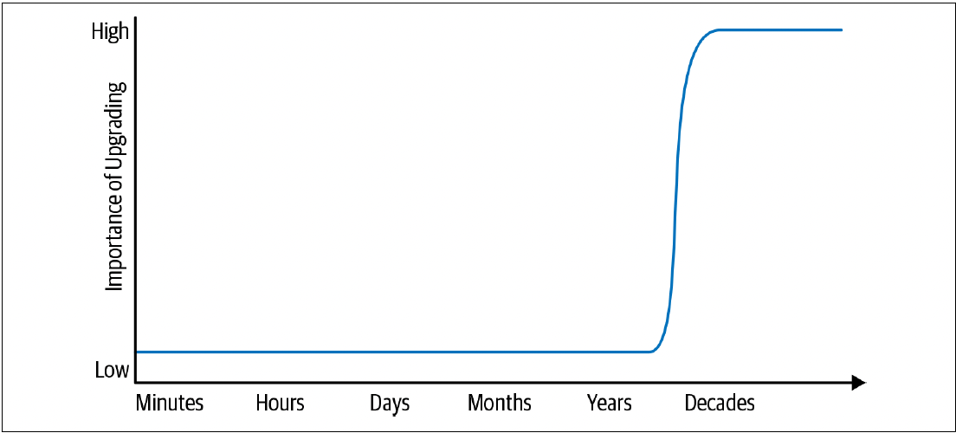
Time And Change
Lifespan and importance of upgrade
The low and high points on the expected life span spectrum suggest that there’s a transition somewhere
Somewhere along the line between a one-off program and a project that lasts for decades, a transition happens: a project must begin to react to changing externalities

Slide 21
Time And Change
Project Sustainability
Reliably stay current going forward → essence of long-term sustainability for your project
Sustainability requires planning and managing the impact of required change
Achieve sustainability, largely through trial and error
Concretely, how does short-term programming differ from producing code with a much longer expected life span?
Need to be much more aware of the difference between “happens to work” and “is maintainable.”
There is no perfect solution for identifying these issues
Keeping software maintainable for the long-term is a constant battle

Slide 22
Time And Change
Hyrum’s Law
“With a sufficient number of users of an API, it does not matter what you promise in the contract: all observable behaviours of your system will be depended on by somebody.”
“it works” vs “it is maintainable”, which to choose?
Discussions of change and maintenance over time must be aware of Hyrum’s Law
Depends crucially on the expected life span of the code in question

Slide 23
Time And Change
Why Not Just Aim for “Nothing Changes”?
For most projects, over a long enough time period, everything underneath them might need to be changed
Most projects have far more exposure to shifting underlying technology
Efficiency concerns are particularly subtle: the original design might have been perfectly logical and following reasonable best practices
It’s only after an evolution of backward-compatible changes that a new, more efficient option becomes important.
No mistakes were made, but the passage of time still made change valuable.

Slide 24
Scale and Efficiency
Scale
If changing something comes at inordinate cost, it will likely be deferred
If costs grow super linearly over time, the operation clearly is not scalable
Eventually, time will take hold and something unexpected will arise that you absolutely must change
Everything your organization relies upon to produce and maintain code should be scalable in terms of overall cost and resource consumption. Example: human costs, traditional resources, the development of that software, codebase.
In particular, everything your organization must do repeatedly should be scalable in terms of human effort

Slide 25
Scale and Efficiency
Factors that Affect the Flexibility of a Codebase
Expertise
  Know how to do. Example: Have done hundreds of compiler upgrades across many platforms
Stability
  Less change between releases by adopting releases more regularly
Conformity
  Less code that hasn’t been through an upgrade already
Familiarity
  Because of the regularity, redundancies can be spotted easily in the process of performing an upgrade and attempt to automate
Policy
  The net effect of these processes is that upgrades remain feasible because infrastructure teams do not need to worry about every unknown usage, only the ones that are visible in our CI systems.

Slide 26
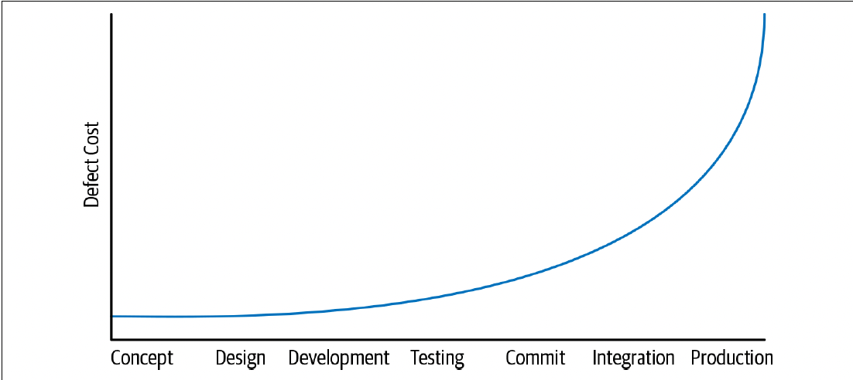
Scale and Efficiency
“Earlier mistakes are cheaper mistakes.”
Shifting left
Shifting problem detection to the “left” earlier on this timeline makes it cheaper to fix than waiting longer

Slide 27
Trade-offs and costs
Trade-offs
Understand how to program, understand the lifetime of the maintained software, and understand how to maintain as scaling up with more engineers producing and maintaining new features
All that is left is to make good decisions
Decisions → impact costs
Cost → effort and can involve any or all of these factors:
  Financial costs → money
  Resource costs → CPU time
  Personnel costs → engineering effort
  Transaction costs → what does it cost to take action?
  Opportunity costs → what does it cost to not take action?
  Societal costs → what impact will this choice have on society at large?

Slide 28
Trade-offs and costs
Decision making
Decisions in an engineering group should come down to very few things:
  We are doing this because we must (legal requirements, customer requirements).
  We are doing this because it is the best option (as determined by some appropriate decider) we can see at the time, based on current evidence.
Decisions should not be “We are doing this because I said so.”

Slide 29
Trade-offs and costs
Inputs to Decision making
Based on data → two common scenarios:
  All of the quantities involved are measurable or can at least be estimated.
    Example: evaluating trade-offs between CPU and network, or dollars and RAM, or considering whether to spend two weeks of engineer-time in order to save N CPUs across our datacentres.
  Some of the quantities are subtle, or unable to measure them.
    Example: “We don’t know how much engineer-time this will take”, even more nebulous: how do you measure the engineering cost of a poorly designed API? Or the societal impact of a product choice?

Slide 30
Trade-offs and costs
Deciding: time vs Scale
Occasionally time and scale come into conflict
As with most software engineering decisions, there isn’t a one-size-fits-all answer
Consistency has great value, but generality comes with its own costs

Slide 31
Trade-offs and costs
Revisiting Decisions, Making Mistakes
One of the unsung benefits of committing to a data-driven culture is the combined ability and necessity of admitting to mistakes
Time doesn’t only trigger changes in technical dependencies and software systems, but in data used to drive decisions
Data informs decisions, but data will change over time, and new data may present itself → decisions will need to be revisited from time to time over the life span of the system in question
For long-lived projects → it’s critical to have the ability to change directions after an initial decision is made and, importantly, the deciders need to have the right to admit mistakes

Slide 32
The software Engineering Profession
Characteristics of the Software Engineering Profession
Specialized Knowledge and Education: Software Engineering requires a deep understanding of both theoretical and practical aspects of software development, including algorithms, data structures, system design, and project management
Adherence to Ethical Standards: Professional software engineers must adhere to ethical guidelines to ensure the responsible development and deployment of software.
Commitment to Quality and Best Practices: Ensuring the quality of software through best practices is a hallmark of the profession.
Professional Development and Lifelong Learning: The dynamic nature of technology requires software engineers to engage in lifelong learning to stay current with advancements.

Slide 33
The software Engineering Profession
Roles and Responsibilities in Software Engineering
Software Developer/Engineer
  Design and Implementation: Writing code, designing system architecture, and implementing software solutions
  Maintenance: Updating and improving existing software systems to enhance functionality and performance
Project Manager
  Planning and Coordination: Defining project scope, timelines, and resource allocation.
  Risk Management: Identifying potential risks and implementing mitigation strategies.
Quality Assurance (QA) Engineer
  Testing: Developing and executing test plans to identify and resolve defects.
  Process Improvement: Establishing quality standards and improving testing methodologies.
Systems Analyst
  Requirements Gathering: Understanding and documenting user requirements and system specifications.
  System Design: Translating requirements into technical specifications and system designs.

Slide 34
The software Engineering Profession
Career Paths in Software Engineering: Specializations
Frontend Development: Focuses on user interface and user experience design.
Backend Development: Involves server-side logic, databases, and application integration.
DevOps Engineering: Combines software development with IT operations to streamline the development lifecycle.
Data Engineering: Deals with designing and managing data pipelines and architectures.
Machine Learning Engineering: Specializes in developing and deploying machine learning models.

Slide 35
The software Engineering Profession
Career Paths in Software Engineering: Advancement Opportunities
Senior Software Engineer: Takes on more complex projects and mentors junior engineers.
Technical Lead/Team Lead: Manages a team of developers, oversees project progress, and ensures technical standards.
Software Architect: Designs high-level software structures and frameworks.
Engineering Manager: Focuses on team management, project coordination, and strategic planning.
Chief Technology Officer (CTO): Oversees the technological direction of an organization.

Slide 36
References
Titus Winters, Tom Manshreck, and Hyrum Wright. (2020). Software Engineering at Google: Lesson Learned from Programming Over Time. 1st. O’Reilly Media. California. ISBN: 978-1492082798. Page 5-24.
Roger Pressman and Bruce Maxim. (2020). Software Engineering: A Practitioner's Approach. 9th E. McGraw- Hill. New York. ISBN: 9781259872976.

